Slide 1

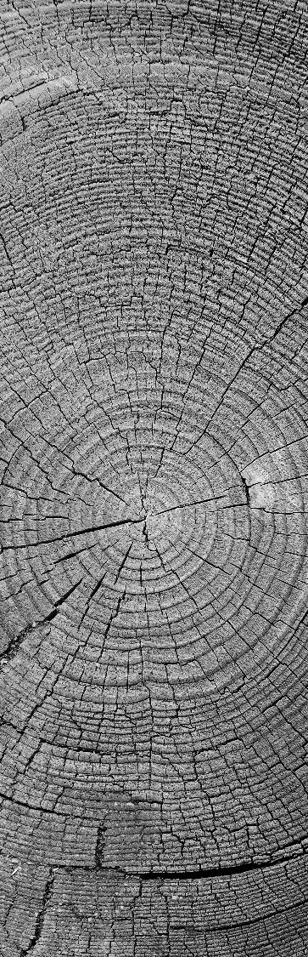

HOME AUTOMATION USING MQTT PROTOCOL
Prepared by:-
Mudra Barhate(16ec007)
Bhavin Bhamwani(16ec008)
Raj patel(16ec082)
Guided by:- Prof. Hitesh Patel
(Assistant Professor)

Slide 2
INDEX
Introduction
Requirements
Flow chart
What is MQTT
Application
Advantages
Limitations
Results
Conclution
Reference

Slide 3
Introduction
Homes of the 21st century will become more and more self-controlled and automated.
This project presents the overall design of Home Automation System (HAS) wireless system.
This system is designed to assist and provide support in order to fulfill the needs of elderly and disabled in home.
Also, the smart home concept in the system improves the standard living at home.
The system intended to control electrical appliances and devices in house with Relatively design, user-friendly interface and ease of installation.
The main overview for the project is to be able to communicate with different electrical devices within the home wirelessly.

Slide 4
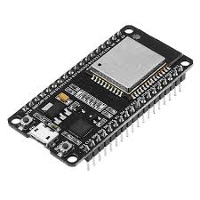
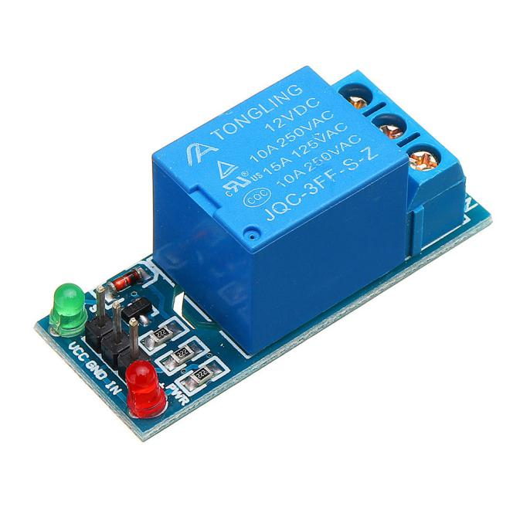
Requirements
Hardware Requirements
ESP32
Relay Module
Connecting wire
Battery
Software requirements
Arduino IDE
Mqtt dash mobile app
ESP32
RELAY

Slide 5
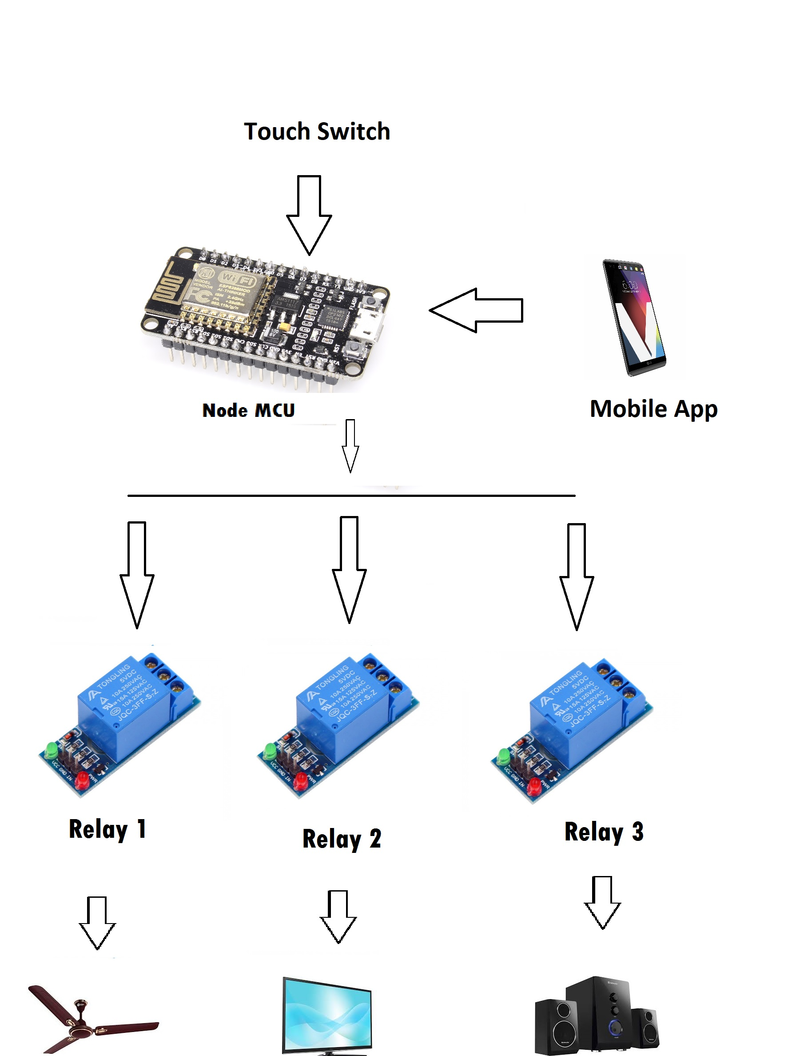
Flow chart

Slide 6
WHAT IS MQTT
MQTT is one of the most commonly used protocols in IoT projects. It stands for MessageQueuingTelemetryTransport.
In addition, it is designed as a lightweight messaging protocol that uses publish/subscribeoperations to exchange databetween clients and the server.
We have used MQTT server in this project to get an efficient system as it well known for its fastness, Due to it efficience the famous social medias like facbook messenger and whatsapp messenger also using this MQTT Server.
MQTT is a machine-to-machine (M2M)/"IOT" connectivity protocol. It was designed as an extremely lightweight publish/subscribe messaging transport.
It is useful for connections with remote locations where a small code footprint is required and/or network bandwidth is at a premium.
Eg. Automated activity includes the A.C. to an energy saving setting when the house is vacant and get back to the normal setting when the resident is getting ready to come back.

Slide 7
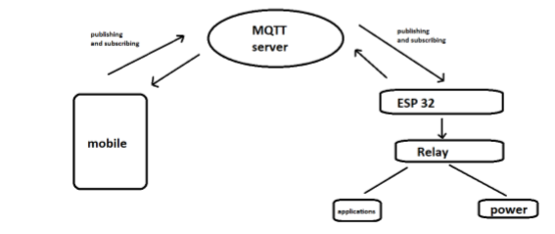
MQTT WORKING DIAGRAM

Slide 8
MQTT Components
Broker, which is the server that handles the data transmission between the clients.
A topic, which is the place a device want to put or retrieve a message to/from.
The message, which is the data that a device receives “when subscribing” from a topic or send “when publishing” to a topic.
Publish, is the process a device does to send its message to the broker.
Subscribe, where a device does to retrieve a message from the broker.

Slide 9
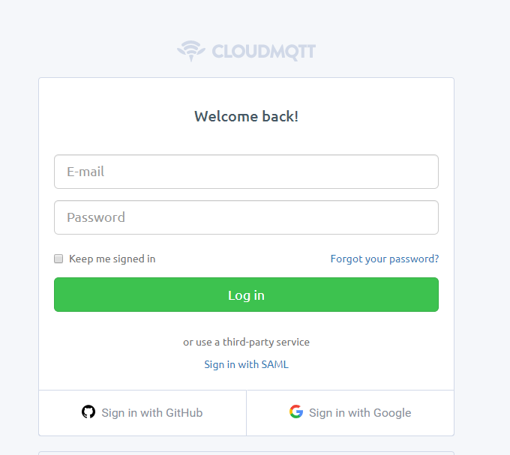
APPLICATION
Step 1: Open CloudMQTT
website and sign up for
Cute Cat plan

Slide 10
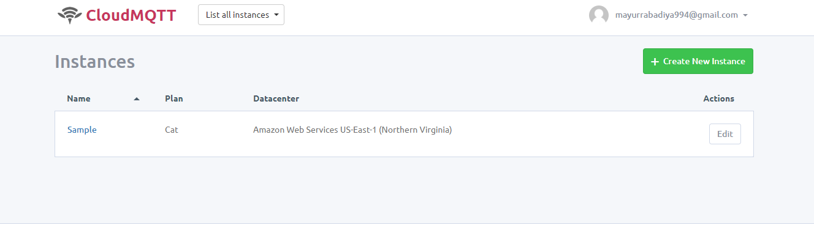
Continue
Step 2 : Click the button sample of created CloudMQTT instance.

Slide 11
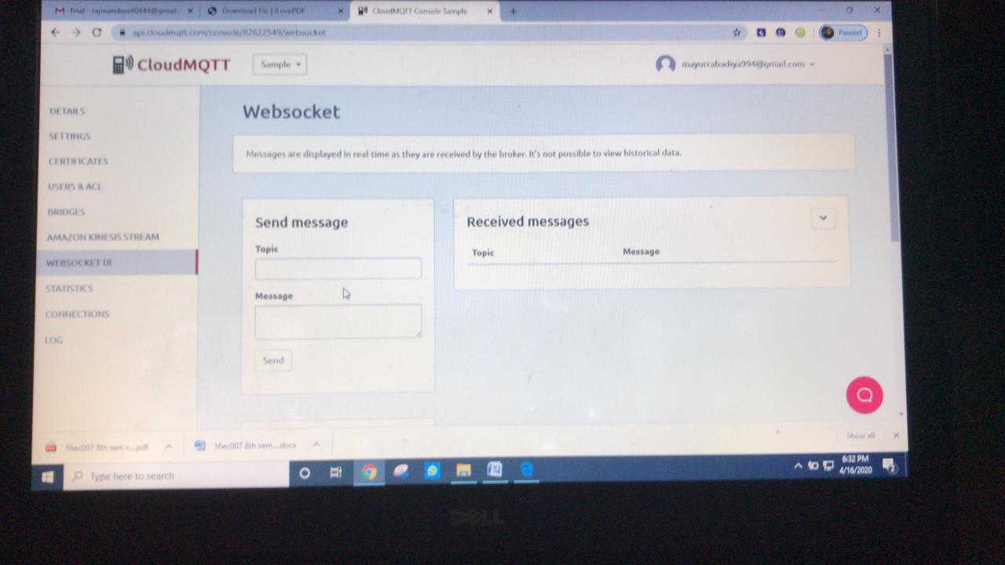
Continue
Step 3: Add all the details

Slide 12
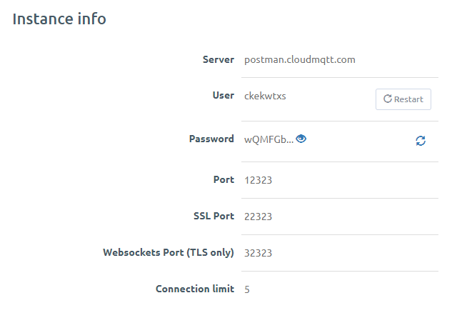
Continue
Step 4 : we will use following details from CloudMQTT console to connect to the CloudMQTT broker from clients (ESP8266 device and IoT MQTT Dashboard android app) to publish and consume messages.

Slide 13
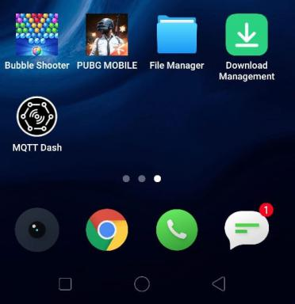
Continue
Step 5: Download MqttDashboard in Android from Google playstore

Slide 14
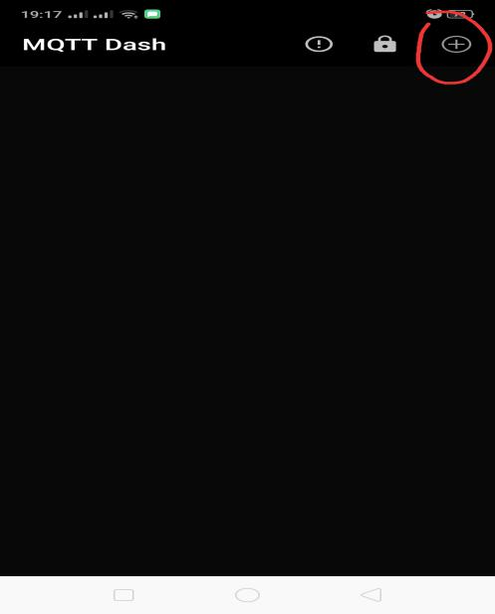
Continue
Step 6: Open the application and click the Plus Sign (+) button to create a connection.

Slide 15
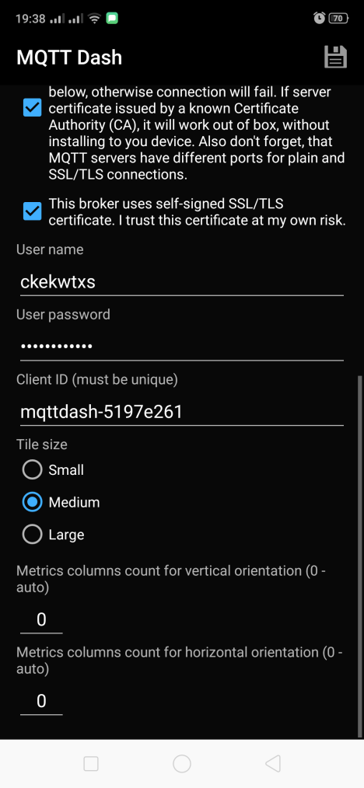
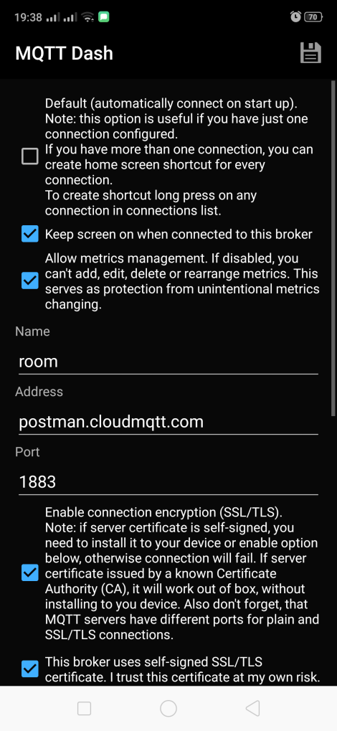
Continue
Step 7:Enter all the details of CloudMQTT instance and click "Save" button.

Slide 16
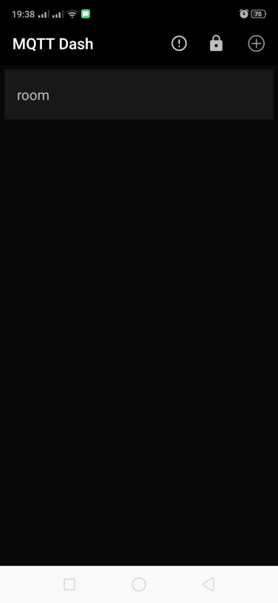
Continue
Step 8:That connection will appear in the dashboard. Open that connection.

Slide 17
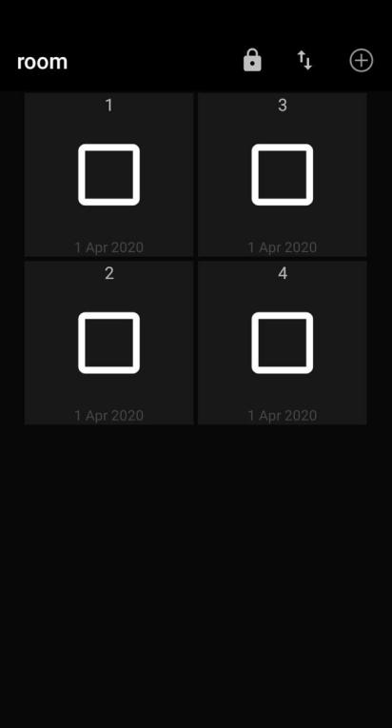
Continue
Step 9:Then click on room and add button and all details. So here we create 4 button in room.

Slide 18
Advantages
Convenient
Customizable
User-friendly
Efficient
Easy installation

Slide 19
limitations
Connect Only 5 device at a time
Internet connection required

Slide 20
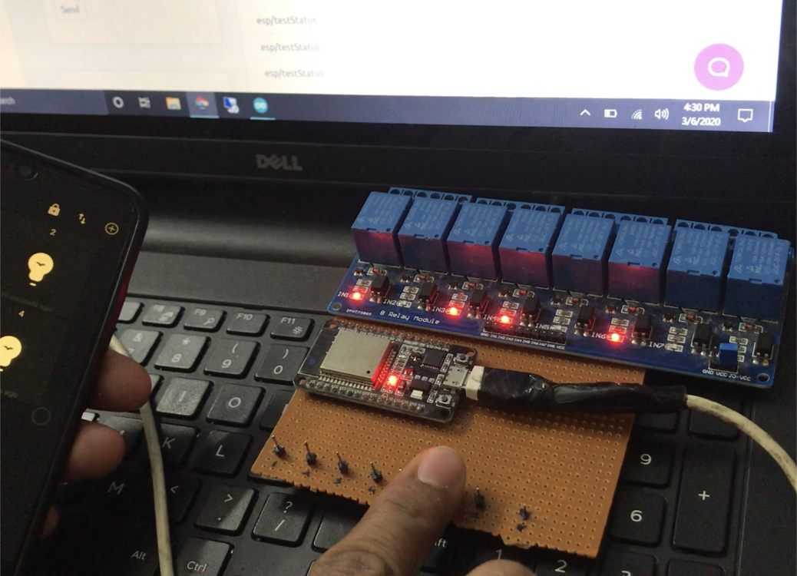
RESULTS
HARDWARE

Slide 21
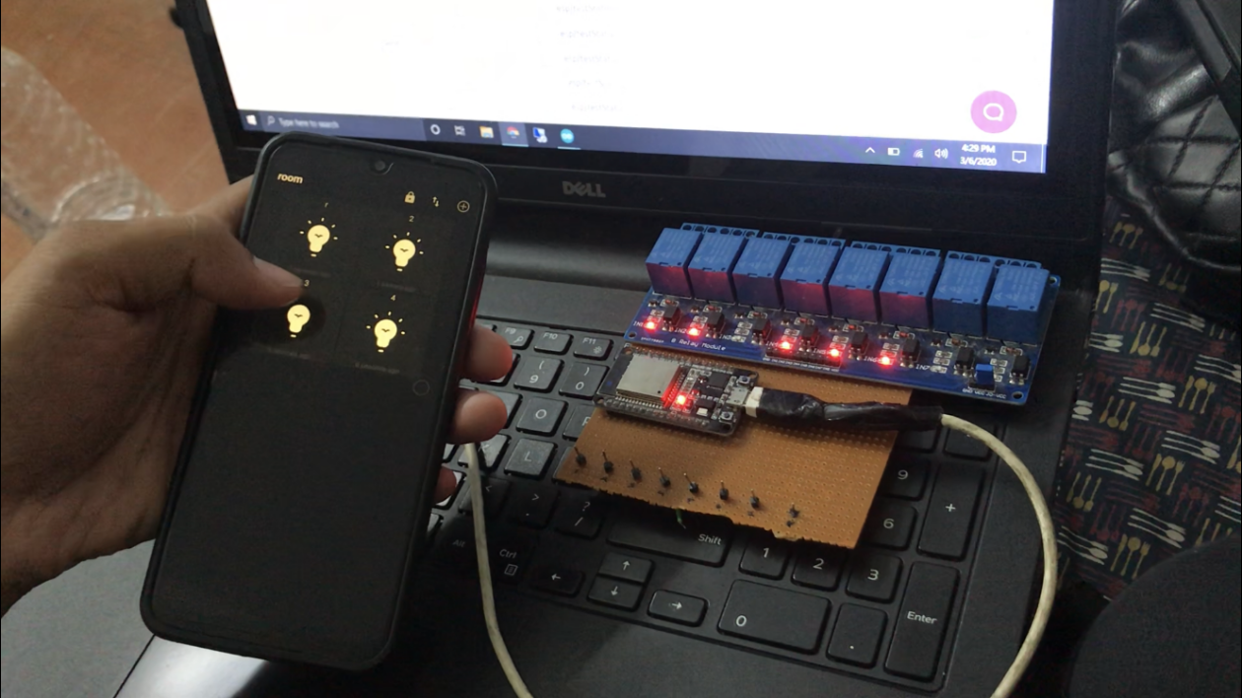
CONTINUE
Led Control Using Application

Slide 22
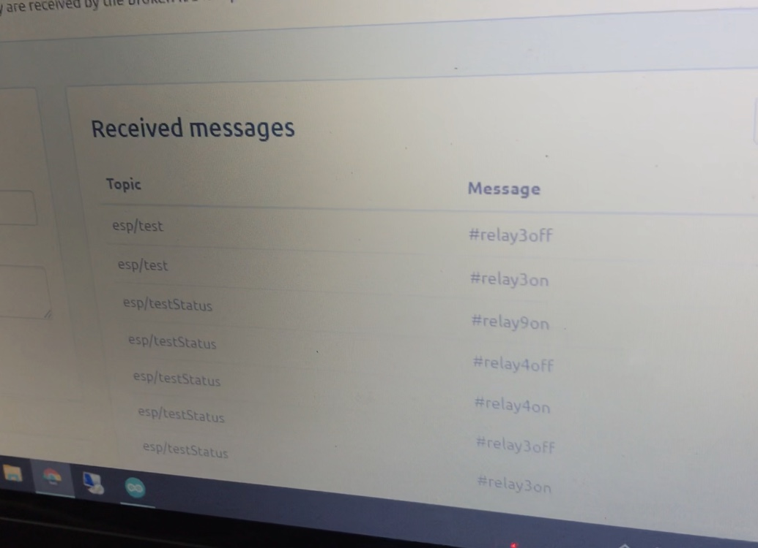
CONTINUE
Status Update
In MQTT Cloud

Slide 23
CONTINUE
LED Control Using Touch Panel

Slide 24
Conclusion
This presentation proposes easy accessiblity, easy-configarble, remotely controlled solution for home automation with your smart phone through the android application which is at your fingertips. The wifi interface between your smart phone and the device has made the process time even more less.

Slide 25
REFERENCE
1. https://www.hackster.io/najad/home-automation-4d76ab
2. https://smarthomeinformer.com/19139/home-automation/
3. http://openrb.com/applications-for-smart-living/
4. https://www.jncet.org/Manuscripts/Volume-8/Issue-5/Vol-8-issue-5-M-08.pdf
5. https://www.srccodes.com/p/article/61/mqtt-cloudmqtt-mqtt-dashboard-android-esp8266-mycropython-home-automation-blub-internet-of-things-iot-m2m
6. https://www.instructables.com/id/Home-Automation-Using-MQTT-and-NodeMcu-or-Arduino/

Slide 26
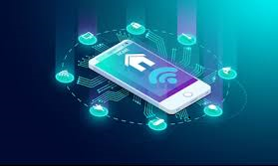
THANK YOU

